Slide 2
Definition of Business Environment
According to Davis, Keith: “ Environment of a business means the aggregate of all conditions, events and influences that surround and affect it.”
Main Features/ Nature of Business Environment:-
Environment is the surrounding situation
Environment is multi-faceted and dynamic
It has a far reaching impact on business
It needs adaptability
Two broad components
Environment is complex and uncertain

Slide 4
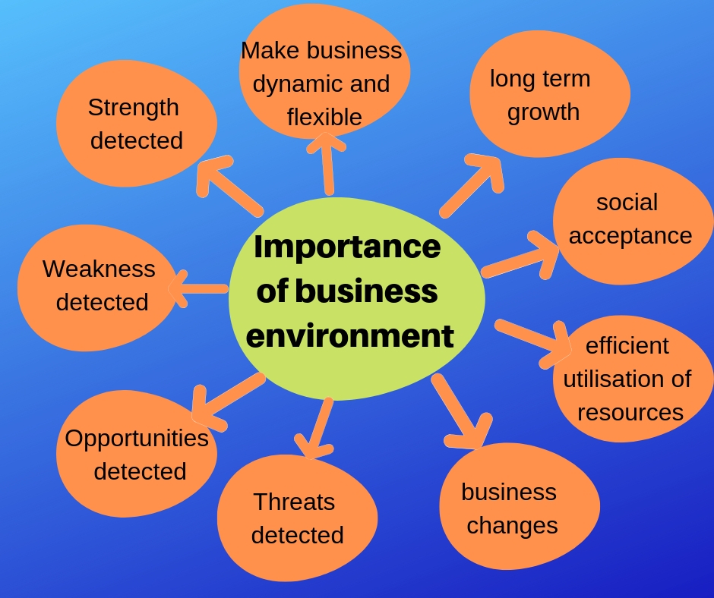

Slide 5
Inter- Relationship between Business and Environment
Closely related concepts
Business has limited capacity to influence environment
Continuous interaction with environment
Integrated approach to business environment is a must for survival

Slide 6
BUSINESS ENVIRONMENT
EXTERNAL
INTERNAL

Slide 7
COMPONENTS OF INTERNAL ENVIRONMENT
Goals of the organization
Value based management
Corporate image
Physical and Financial resources
Human Resources
Labour Relations
R&D facilities
Strong Financial Base

Slide 8
EXTERNAL ENVIRONMENT
MACRO
MICRO

Slide 9
Components of Micro Environment
Corporate Resources
Suppliers
Customers
Middlemen
Competitors
Society

Slide 10
Components of Macro Environment
Political
Economic
Social and Cultural
Technological
Legal
Ecological/ Natural
Demographic
International
Ethical

Slide 11
Educational Environment
Educational Environment is the economic surrounding or situation within which the education , training and manpower development activities are undertaken. It is the education system which creates human capital.
Features of educational environment in India
Influencing factors
Close connection with business
Business supports education
Position of educational environment in India

Slide 12
Impact of Education on Business
Growth of Professionalism in business
Change in attitude
Inflow of social skills in business
Trained leadership in business sector
Creativity and innovation in business
Ensures optimum utilization of resources in business

Slide 13
Measures to improve standards in education
Management Courses- high calibre
Sponsored educational institutions
Privatization and globalization in higher education
Use of modern techniques
Training to teachers
Industry and Academics
Quality education

Slide 14
Measures to improve education environment in India
Expenditure to be raised
Adequate opportunities
Literacy rate to be increased
Funds for research
Quality education
Autonomy
Vocational education and Skill development

